Slide 1
Adventure Works Interim Project
Group 4: Jelena, Adrian, Behram, Lee

Slide 2
Project Questions
What are the regional sales in the best performing country?
What is the relationship between annual leave taken and bonus?
What is the relationship between Country and Revenue?
What is the relationship between sick leave and Job Title (PersonType)?
What is the relationship between store trading duration and revenue?
What is the relationship between the size of the stores, number of employees and revenue?

Slide 3
Q1. What are the regional sales in the best performing country?

Slide 4
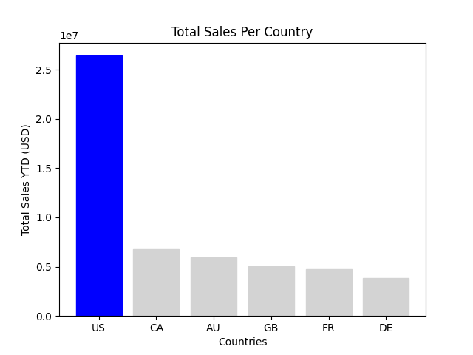
The Best Performing Country
US total = $26,411,059.88

Slide 5
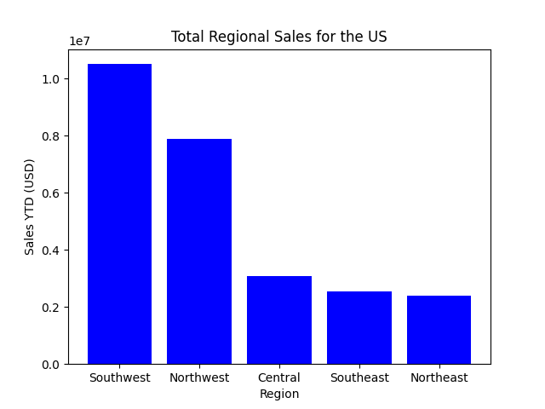
Regional Sales for the Best Performing Country
Southwest total = $10,510,853.87
Northwest = $7,887,186.79
Central = $3,072,175.12
Southeast = $2,538,667.25
Northeast = $2,402,176.85

Slide 6
Q2. What is the relationship between annual leave taken and bonus?

Slide 7
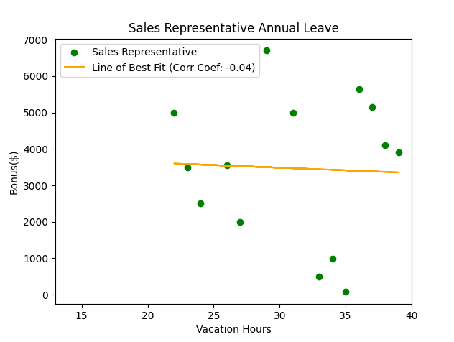
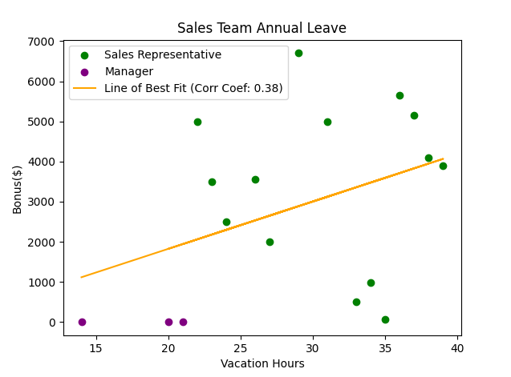
Annual leave and bonus correlation
No correlation
Positive correlation

Slide 8
2
Vacation Hours:
Managers: between 14 and 21
Average: 18h 20 min
Sales Representatives: between 22 and 39
Average: 31h
Bonus Amount:
Between $75.00 and $6,700.00
Average: $3,472.14

Slide 9
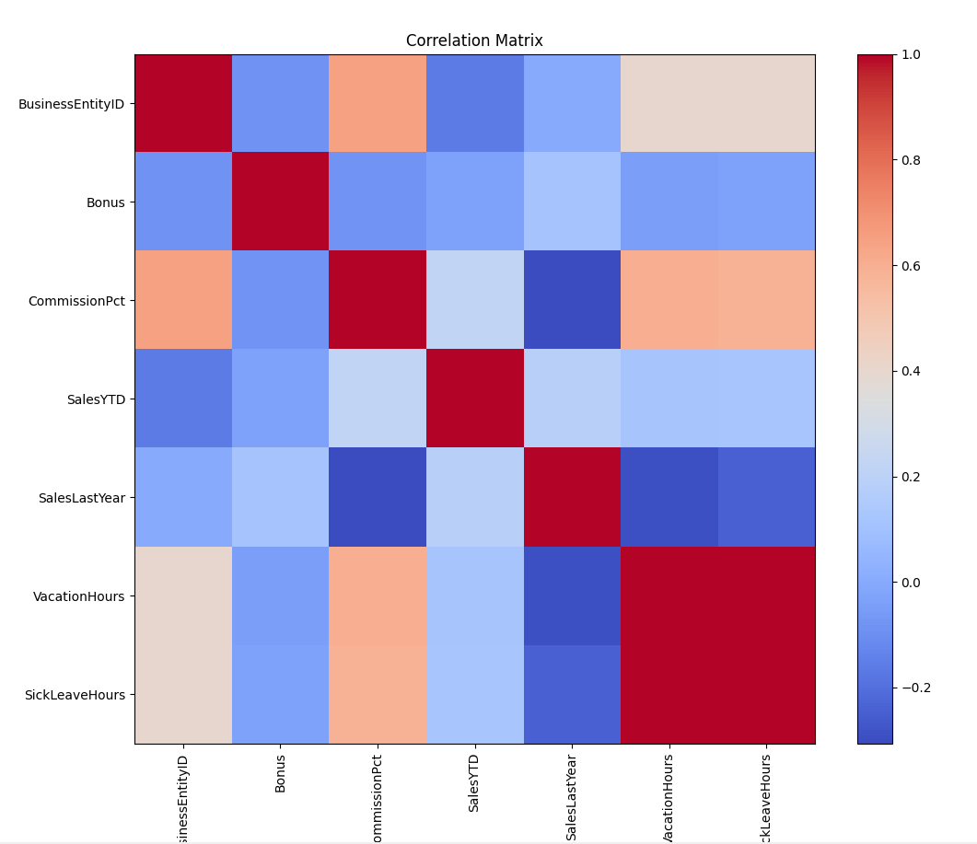
2
No positive correlation between bonus and any other measure
Strong negative correlation between sales last year and commission PCT
Positive correlation between ComissionPCT and date of joining the company.
Positive correlation between Commission PCT and Vacation/Sick Leave Hours

Slide 10
Q3. What is the relationship between Country and Revenue?

Slide 11
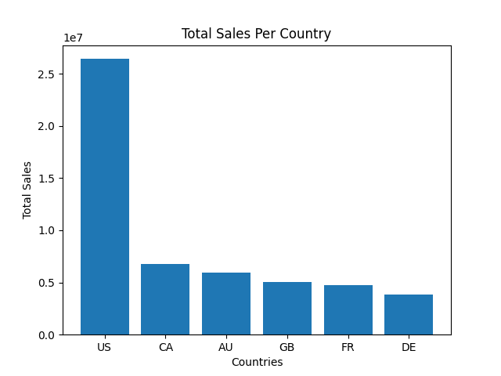

Total Sales Per Country
From Q1, US dominates the chart.
US total YTD = $26,411,059.88

Slide 12
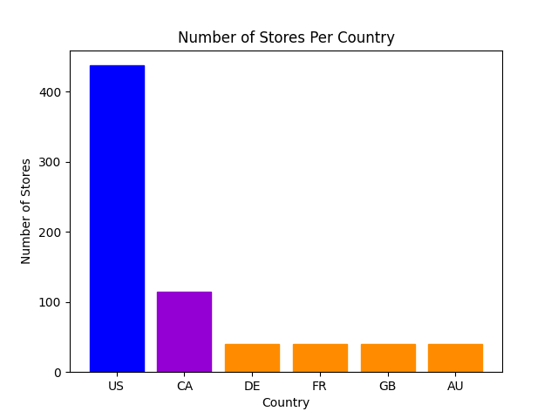
A factor affecting total sales?
US stores = 437
CA stores = 115
DE stores = 40
FR stores = 40
GB stores = 40
AU stores = 40

Slide 13
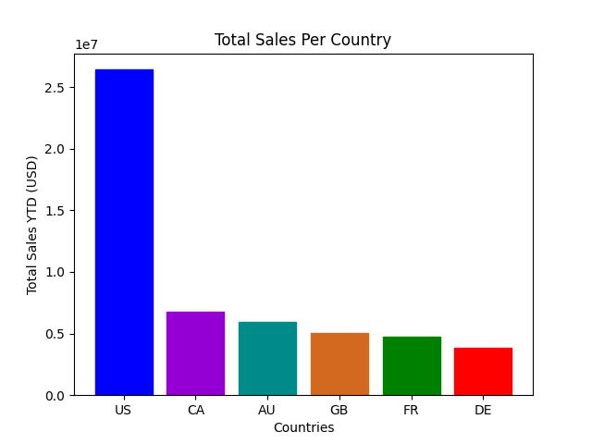
Are there any other factors?
Total Stores for DE, FR, GB, and AU are the same.
Total Sales:
AU = $5,977,814.92
GB = $5,012,905.37
FR = $4,772,398.31
DE = $3,805,202.35
Range = $2,172,612.57
Research into other contributing factors could help increase total sales.

Slide 14
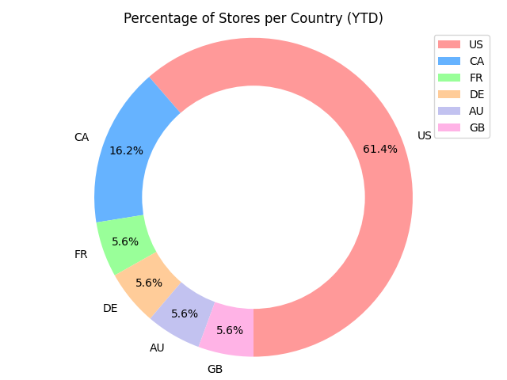
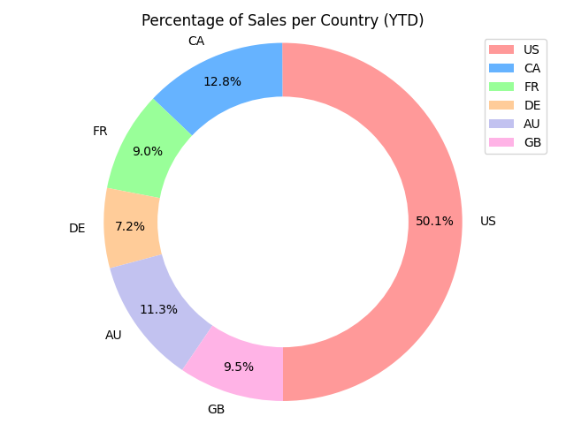
Percentages per Country
CA and US sales less than store percentage.
AU, GB, FR, and DE sales more than store percentage.
The countries with the least number of retailers are proportionally making more revenue for Adventure Works.
Notes:
Realised the colours are different - limited time to change

Slide 15

Why are some retailers more efficient than others?
Selling the right products to the right customers = Increase in Revenue!
Further investigations:
Joining order details to territory to determine the number of orders per country. Are some stores ordering more than others?
Determining the customer base in each country. What are the most sold products?
R&D for products that suit customer base.

Slide 16
Q4. What is the relationship between sick leave and Job Title (PersonType)?

Slide 17
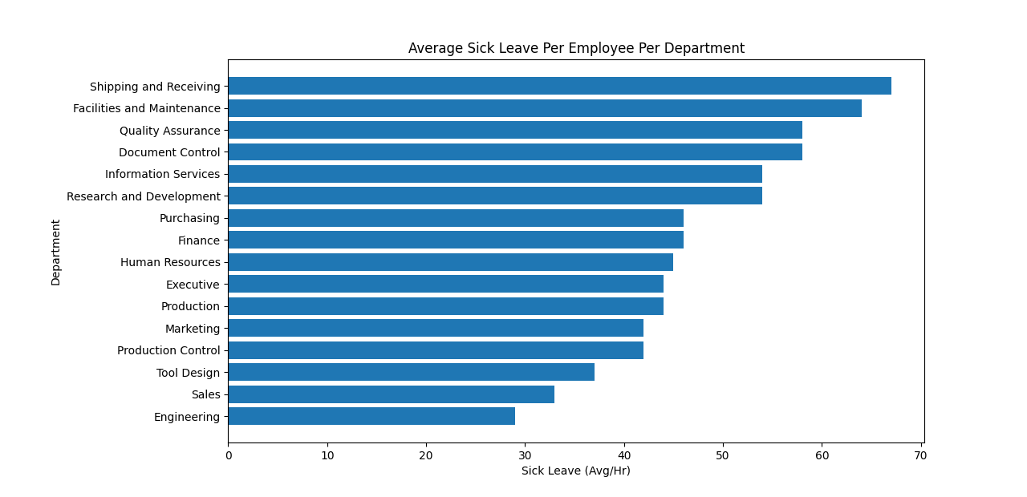
Which Department Takes the most Sick Leave?
General overview of departments
Top 2 departments with highest sick leave are labour intensive.
Average may be skewed depending on no. employees, extreme values etc.
Further graphs used to visualise potential bias…

Slide 18
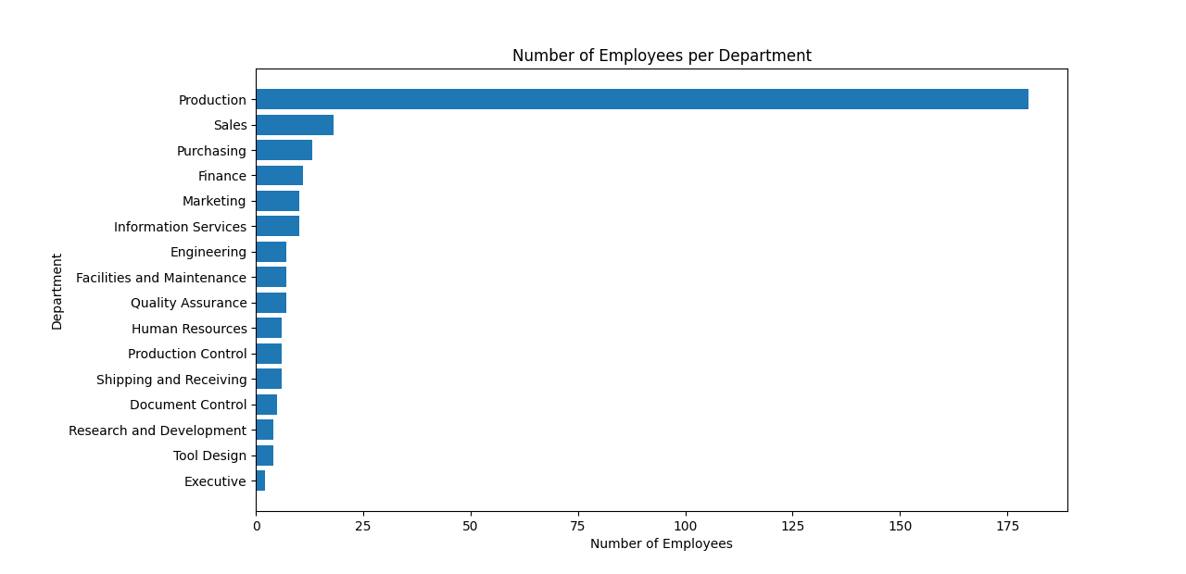
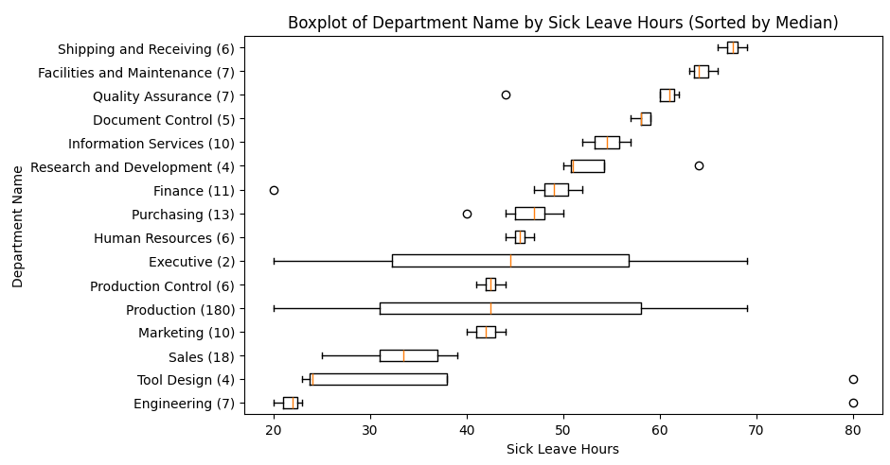
What is the range per department?
IQR generally small
Large IQR employee numbers
Production = 180
DC, R&D, TD
right skewed
Sample bias confirmed by employee numbers
Notes:
Box plot for range per department.
Tool design, document control and R&D heavily skewed to the right (each dep 4-5 employees)

Slide 19
Where are the
Employees
placed?
Production: 180
<25 for all other departments
Worth noting S&R (65-70) vs Engineering (20-25).

Slide 20

Recommendations
Identify reasons for discrepancies:
Analyse sick leave reasons
Take into account long-term health issues
Survey for employee satisfaction
Implementations:
Feedback system
Physical and mental health support
Employee engagement activities

Slide 21
Q5. What is the relationship between store trading duration and revenue?

Slide 22
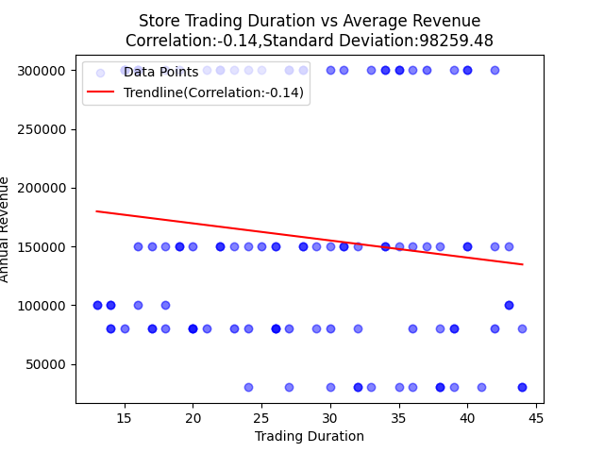
Annual
Weak negative correlation.
Longer the stores are open present with slight decrease in revenue on average.

Slide 23
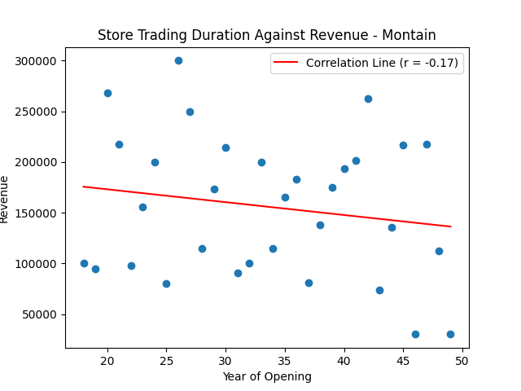
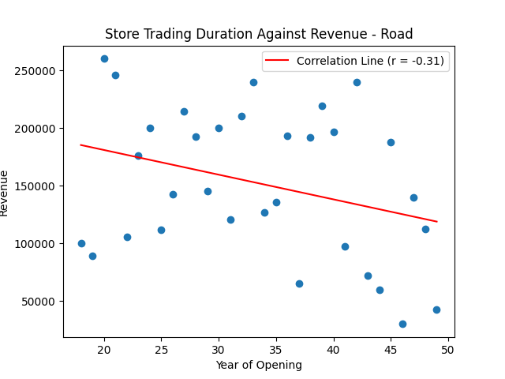
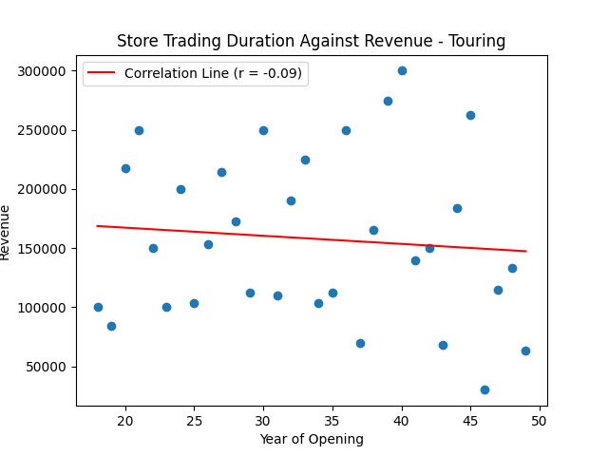
Given a weak negative correlation on Trading duration and annual revenue in general
Classified in different types
Mountain: weak negative correlation
Road: negative correlation
Touring: no correlation
Mountain

Slide 24
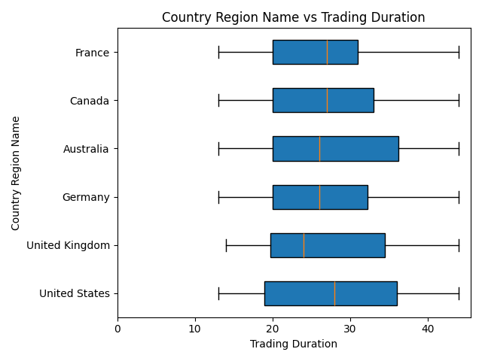
From previous question: US is the main market
Prediction:
Longer opening history in geographical region
Result:
US Highest Median
but not so significant
Conclusion:
Geographical factor can be eliminated in this discussion

Slide 25
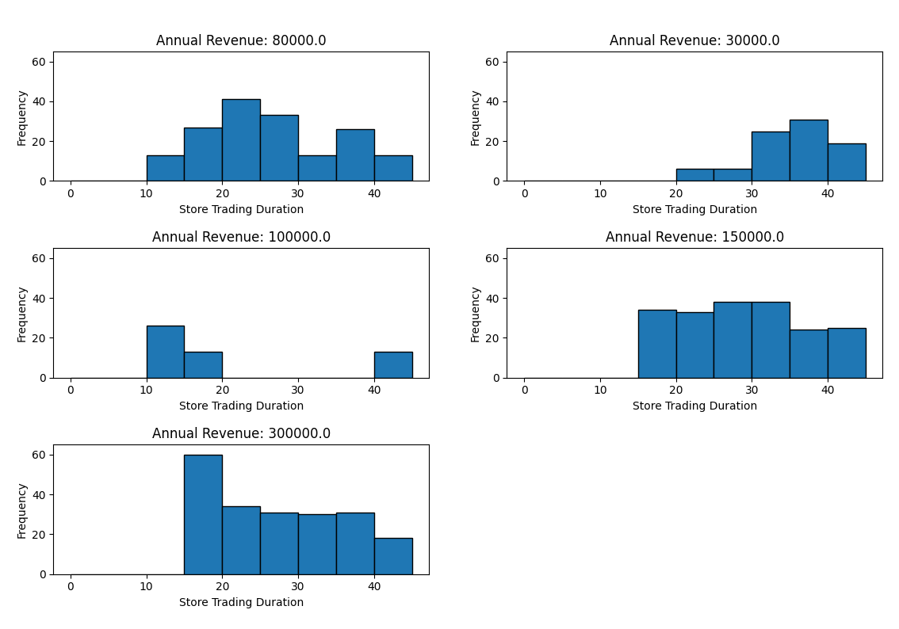
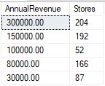
Distribution in different revenue brackets
Insights:
Confirmation of no correlation
Partnered with established stores only >= 10 years in business
Range of revenue from $80,000 to $300,000

Slide 26
Q6. What is the relationship between the size of the stores, number of employees and revenue?

Slide 27
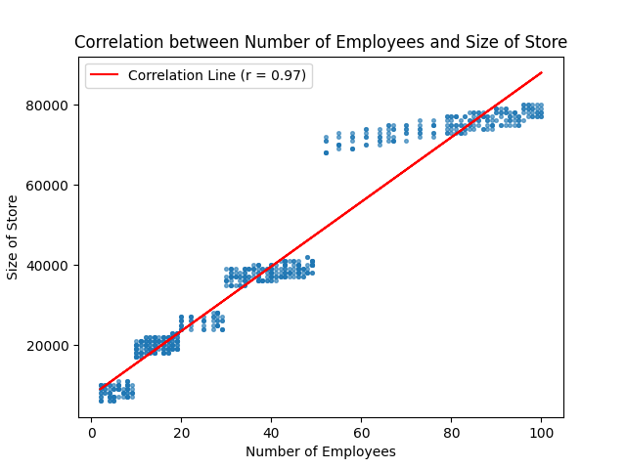
Q6:What is the relationship between the size of the stores, number of employees and revenue
Size of the stores -> independent value
Number of employees -> most related dependent values

Slide 28
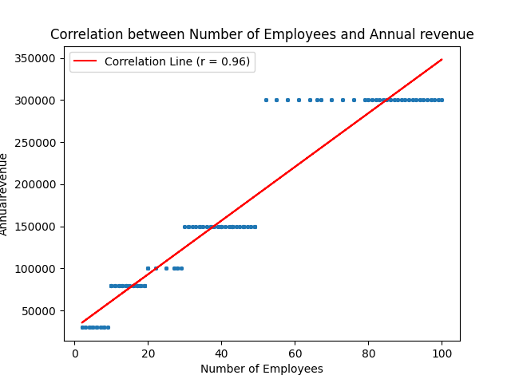
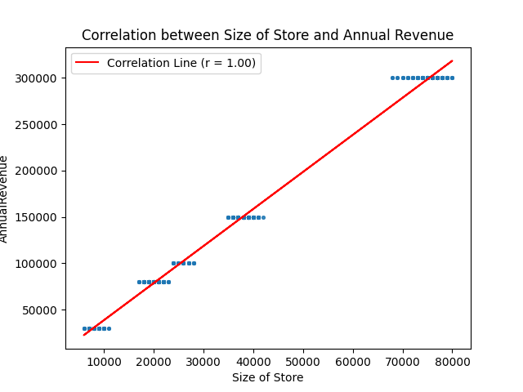
Q6:What is the relationship between the size of the stores, number of employees and revenue

Slide 29
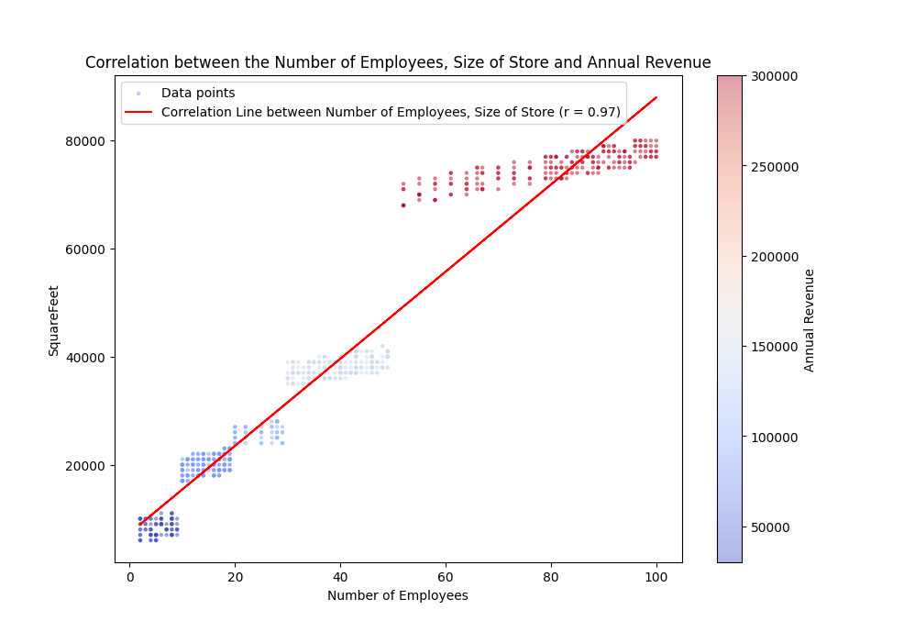
Strong positive correlation between
numbers of employees size and annual revenue
r = 0.97/0.96/1.00
data set maybe not realistic
check on the definition :
predicted rev by survey

